Slide 1
Monster Strike Database
Presented by:
Brant-Andrew Cruz
Sarah Ito
Kelcie Wade
Jason Len

Slide 2
Overview: Background the Monster Strike Game
Monster Strike is like many mobile device games that have collectable monsters/characters with varying characteristics that pertain to each game.

Slide 3
Overview: The Project
Our organization would be providing a collaborative gaming database specifically for use with the Monster Strike game in which strikers/players could compare data through the database and then converse via social media such as Facebook to see what they can do to help each other's game, or to just show off and gloat.

Slide 4
Overview: the Database
To create a database that Strikers (players) of the Monster Strike game could use to primarily enhance the coop mode. To do this, the Monster Strike Database will allow users to:
Search through the Monsters
Search through the Dungeons
Search for other Strikers
Search through their Monster Boxes
Find Help
Offer Help

Slide 5
Project Scheudule: Overview

Slide 6
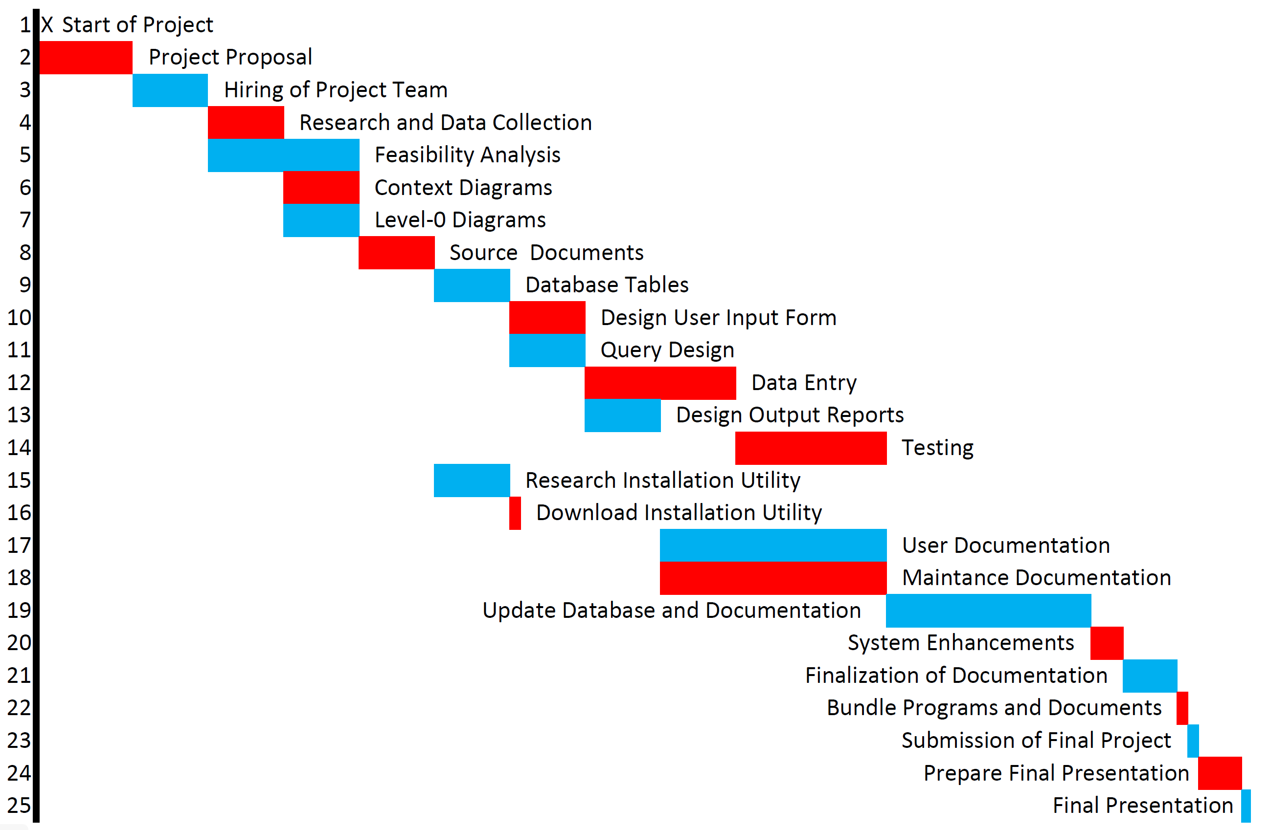
Project Schedule: GANTT

Slide 7
Project Schedule PERT Critical Paths and Slack Time

Slide 8
Project Schedule PERT
A
B
C

Slide 9
Project Schedule: Pert A

Slide 10
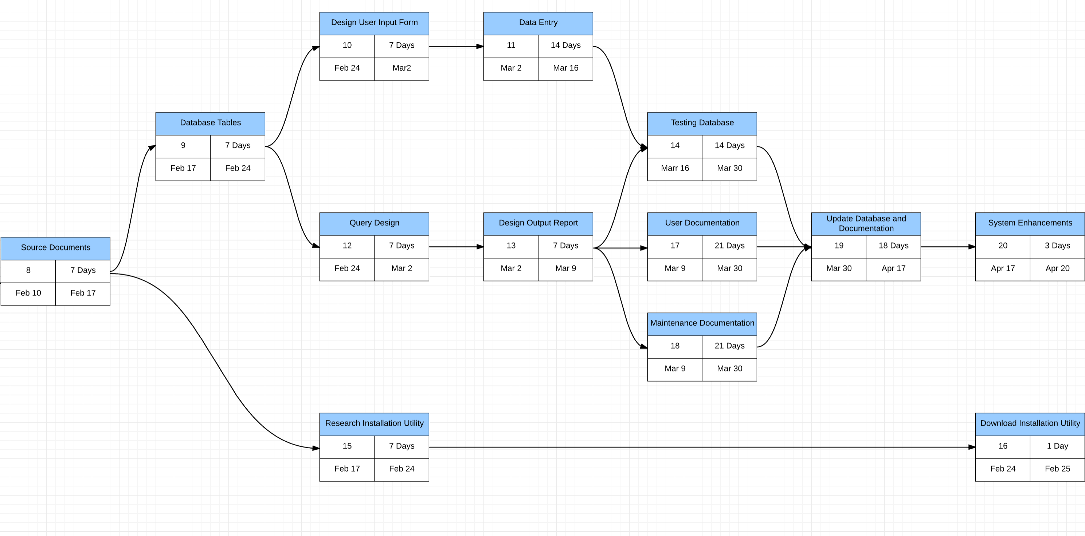
Project Schedule: Pert B

Slide 11
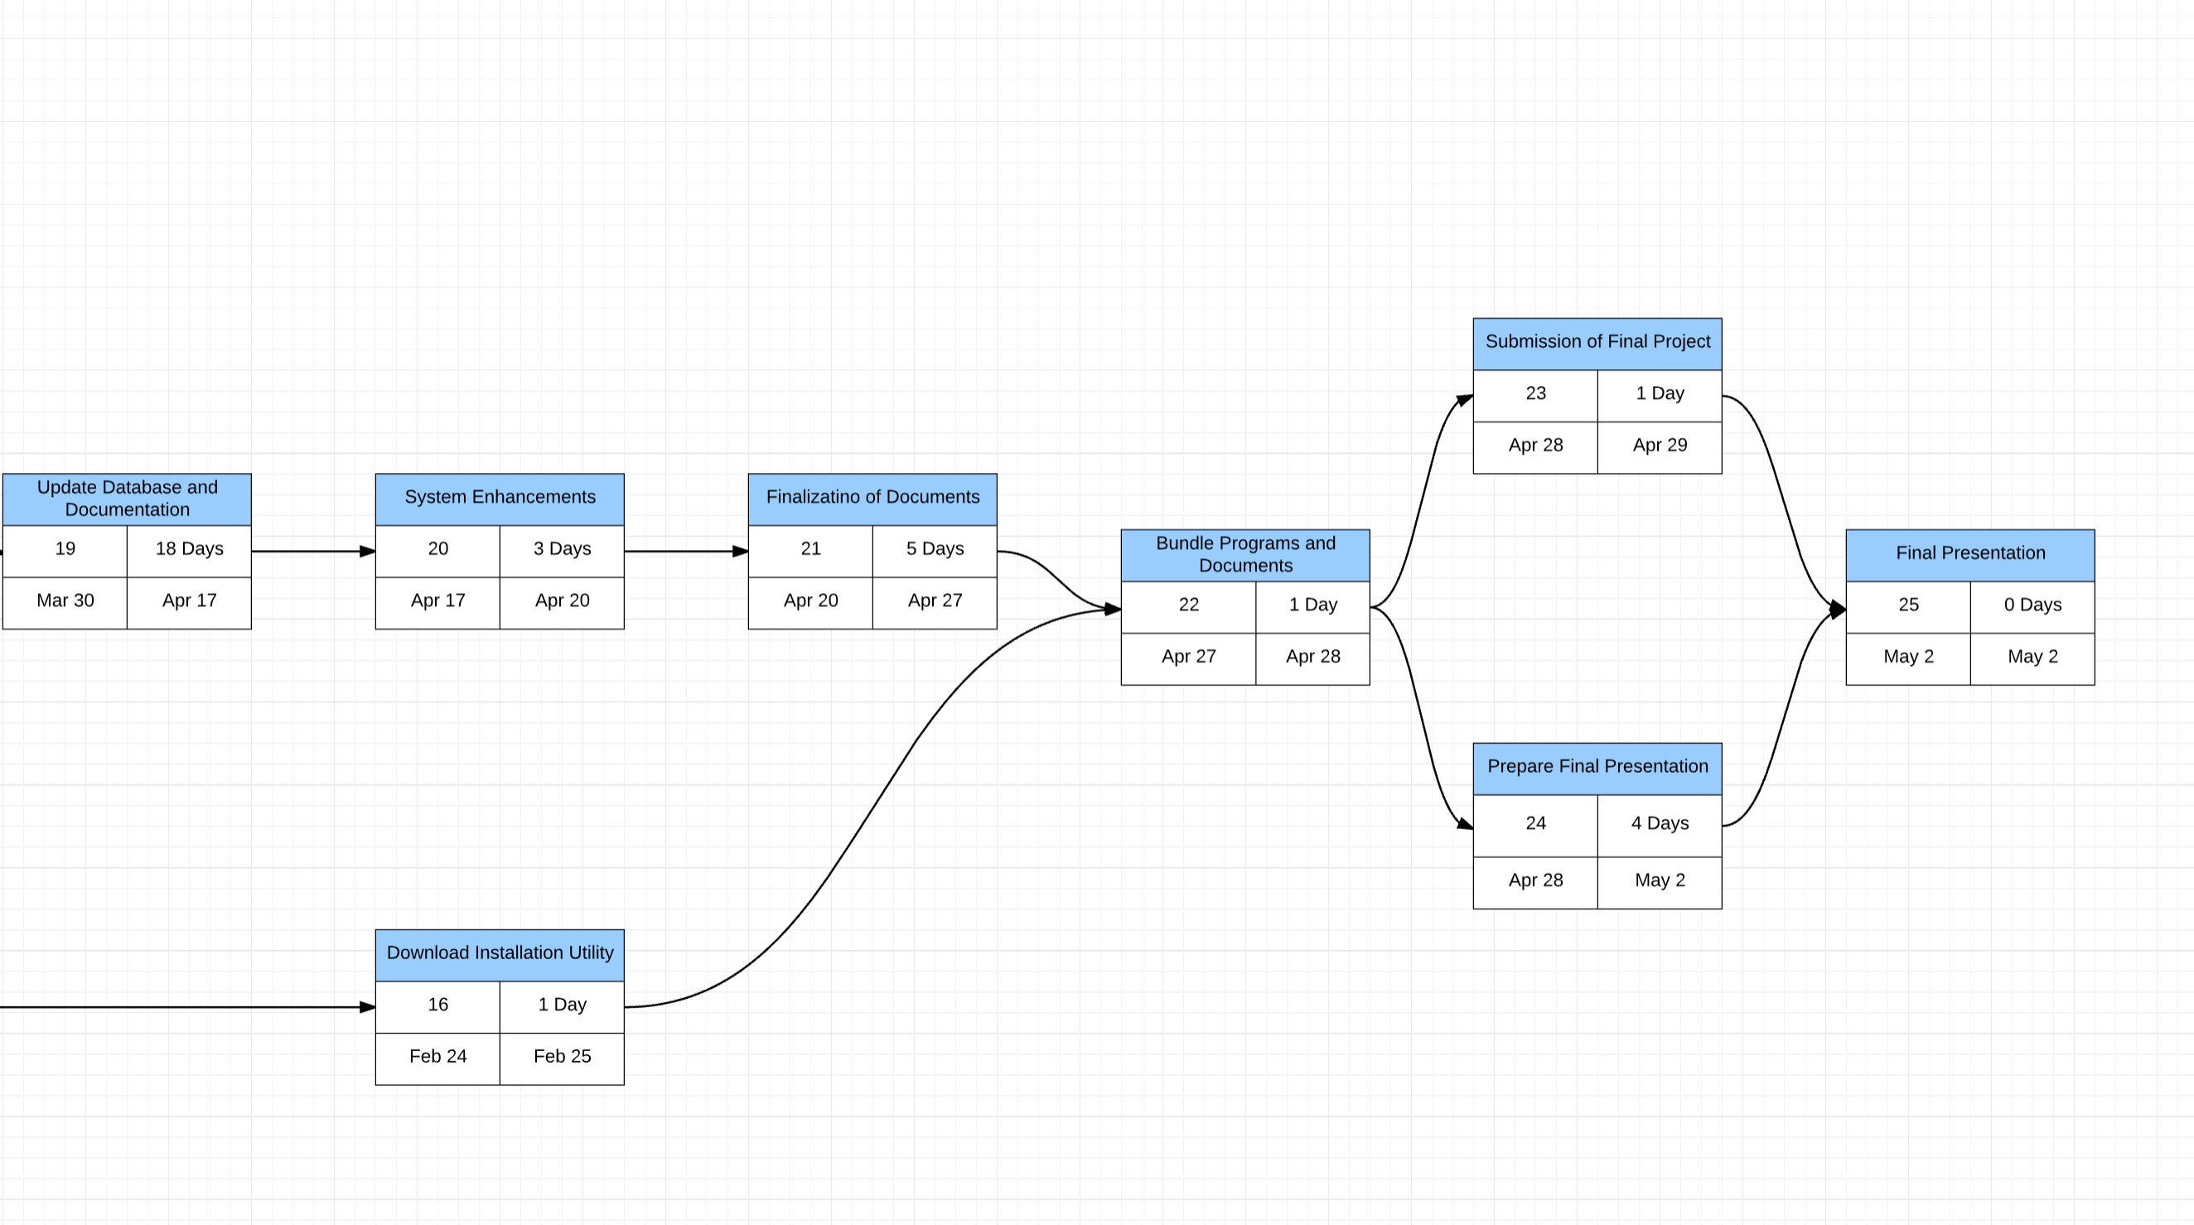
Project Schedule: Pert C

Slide 12
Feasibility Analysis: Overview
Currently there is no system in place that addresses the goals of this project.
Based upon multiple surveys and interviews with various players and administrators of this game, our team has designed a new database and software system that will increase the productivity and enjoyment of the players of this game.
While this system is designed to be used with the original Monster Strike game, its operating platform will be a separate department from the actual game.
This new system will provide an environment in which all end-users and managers have access to real-time data, and there by allowing for a better game experience in which the users can better help out and get help in their game play from their Monster Strike community.

Slide 13
Feasibility Analysis: Economic Overview
Tangible Benefits
proposed $6/year subscription fee at an estimated 3 million subscription.
Intangible Benefits
Fosters the comradery of the Monster Strike game, so users enjoyment of the game increases.
Cost
One-Time
Recurring

Slide 14
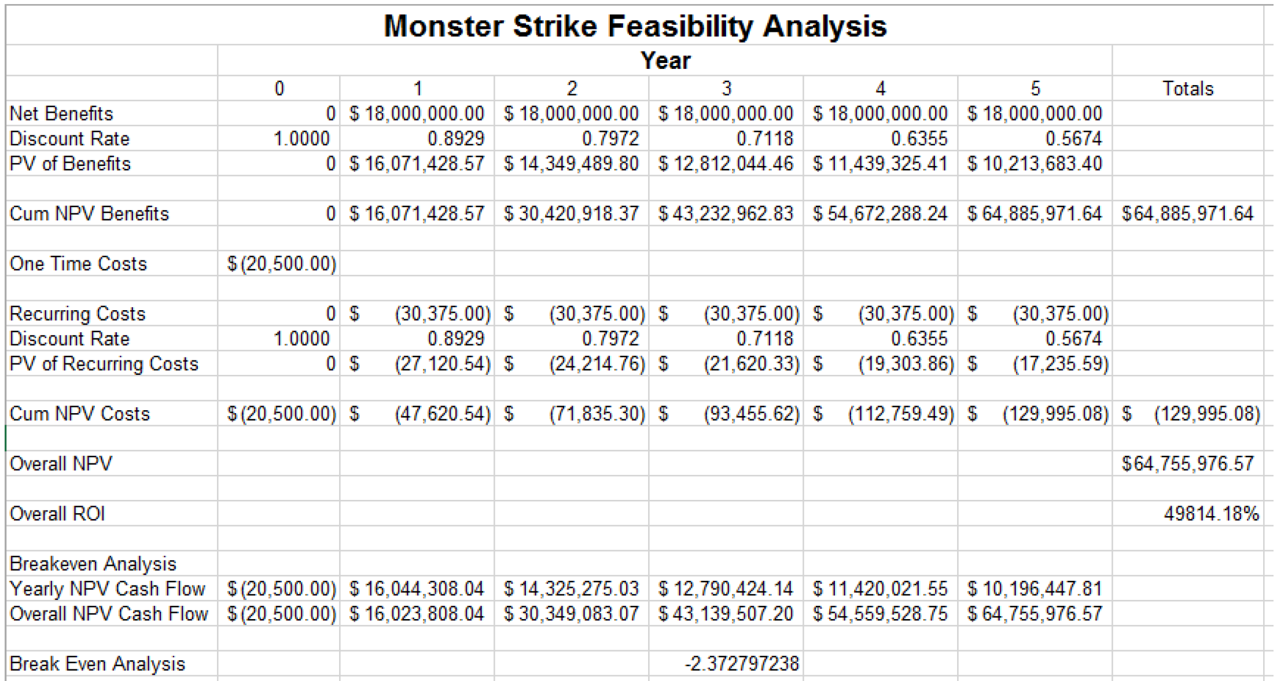
Feasibility Analysis: Economic Optimistic

Slide 15
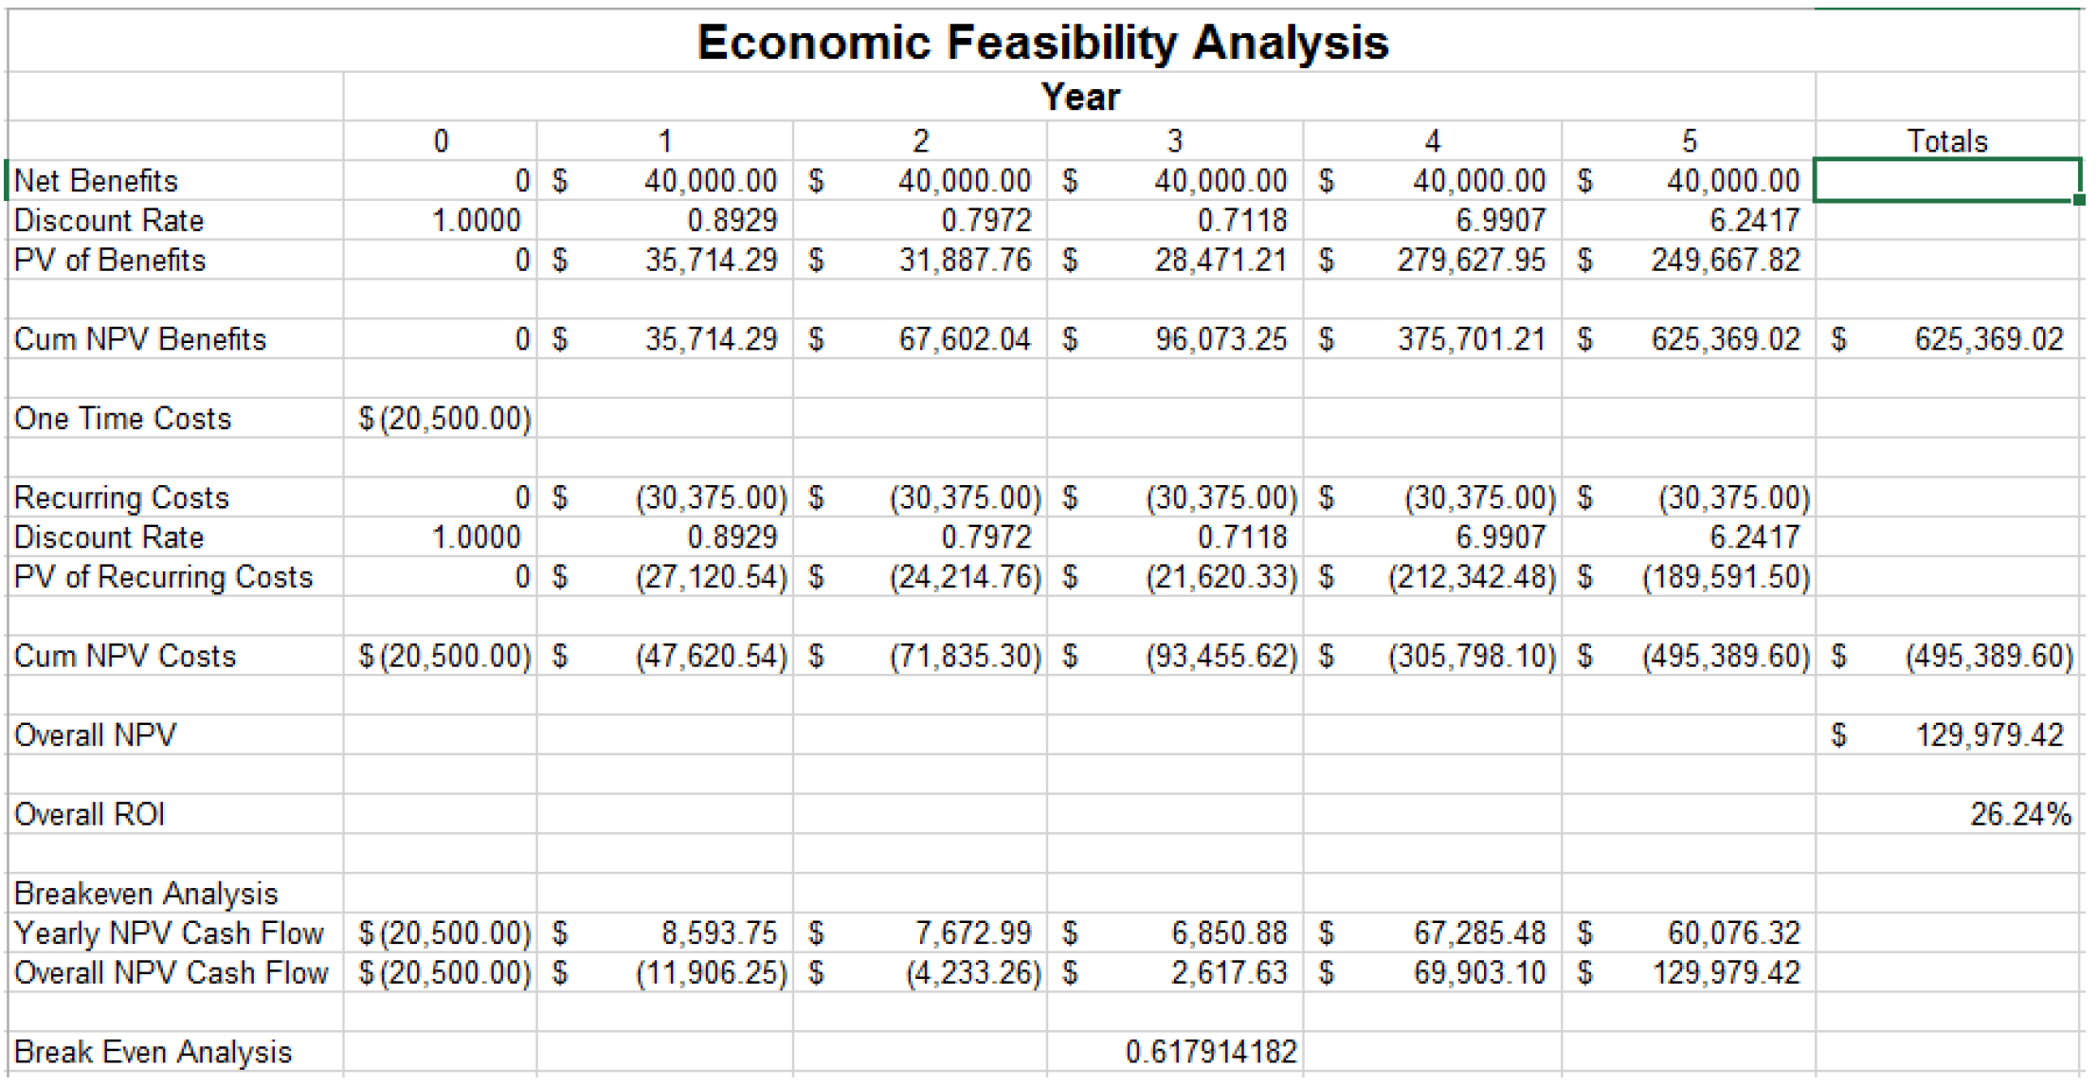
Feasibility Analysis: Economic Pessimistic

Slide 16
Feasibility Analysis: Operational
There is no current operation that provides the users or management with these proposed features. As such, this will be a newly created department that will not affect any other aspects of the company. This new system will allow users to access the game data in an online database of both their own “Monster Boxes” as well as other users. In this manner users will be able to find the appropriate support for the missions that they are currently on by selecting the appropriate players show have complimentary monsters to join them in the real-time game play. This will be done through an external interface and will not affect the original game environment.

Slide 17
Feasibility Analysis: Technical
The proposed system will integrate an online database with a website to foster a greater sense of community for the Monster Strike players. The backbone of the software is the Microsoft package with emphasis on Microsoft Access. The reason for this choice is most users and company employees are familiar with the Microsoft interface and will reduce the amount of training needed to use the system. (People want to play the game, and not have to spend their time figuring out the system.)

Slide 18
Feasibility Analysis: Schedule
The development team has proposed a timeline that is compatible with the time frame allotted. For more information see the PERT or Gantt timelines. As this will be a newly created department that will be run off its own web and database servers, it is expected to cause no disruptions to any existing operations.

Slide 19
Feasibility Analysis: Legal and Contractual
Based in California, Home of the MIXI cooperation
§92F-3, CRS, defines “government record” and “personal record” as used in Chapter 92F, Uniform Information Practices Act (Modified). Chapter 626, CRS, Title X, Rule 1001, defines “public record” as part of the Rules of Evidence.
Act 135, SLH 2006 (SB 2290 SD2, HD1, CD1), relating to Protection from Security Breaches
Act 136, SLH 2006 (SB2292 SD2, HD1, CD1), relating to Destruction of Personal Information Records
Act 137, SLH 2006 (SB2293 SD2, HD1, CD1), relating to Social Security Number (SSN) Protection
Act 135, SLH 2006 and Act 136, SLH 2006 Billing

Slide 20
Feasibility Analysis: Political
This system is for use with a free international game that users voluntarily play. For users to use this system, there is a monthly/yearly subscription that users voluntarily choose to play and can cancel at any time, there is no foreseen political impact. Therefore, a Political feasibility is not needed at this time.

Slide 21
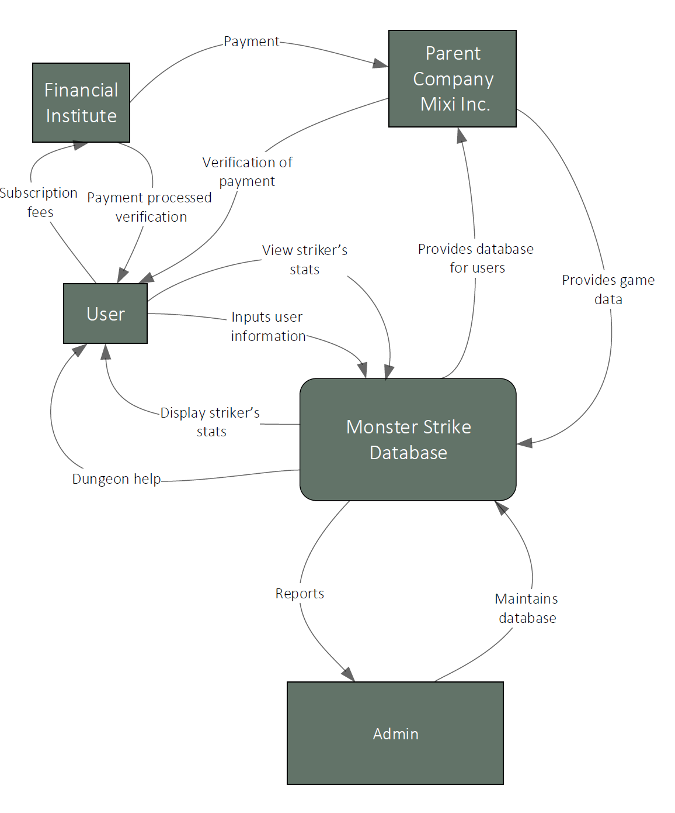
Dataflow Diagram: Context Diagram

Slide 22
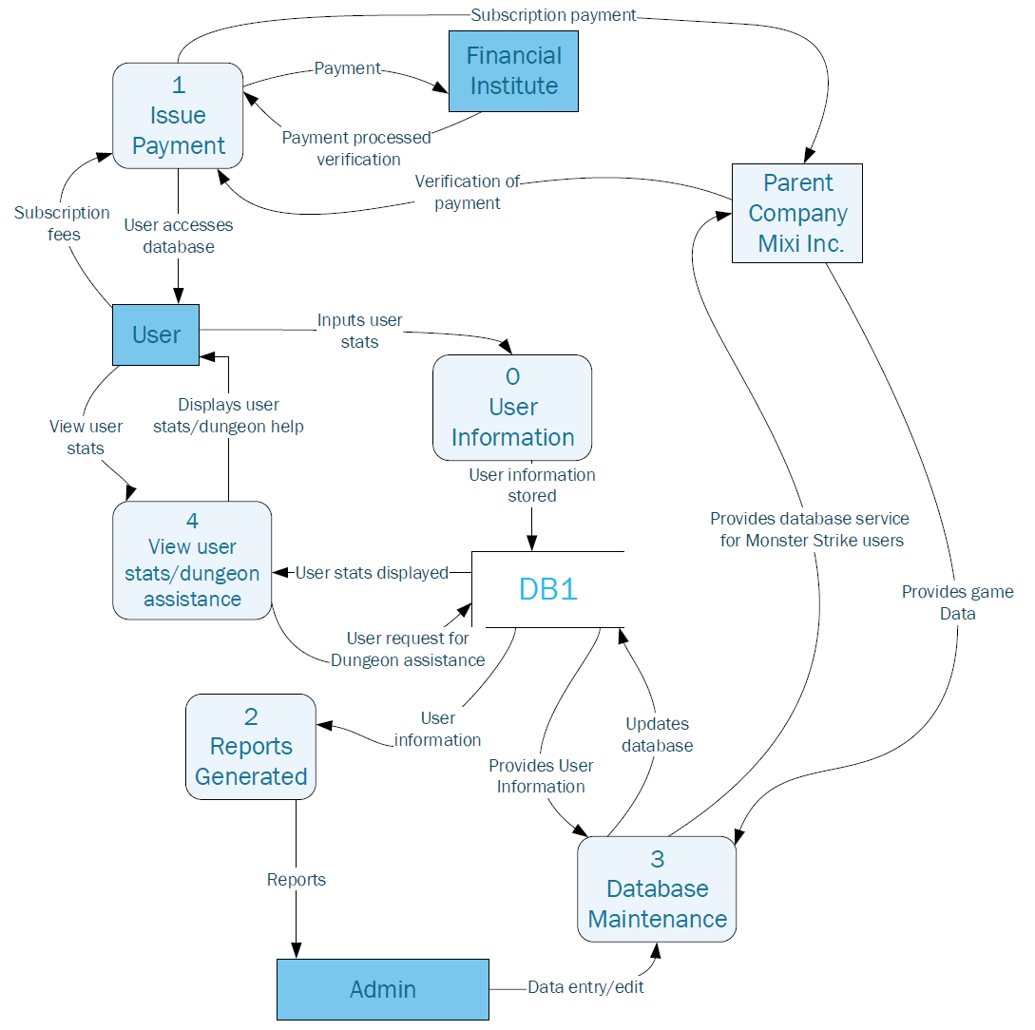
Dataflow Diagram: Level 0

Slide 23
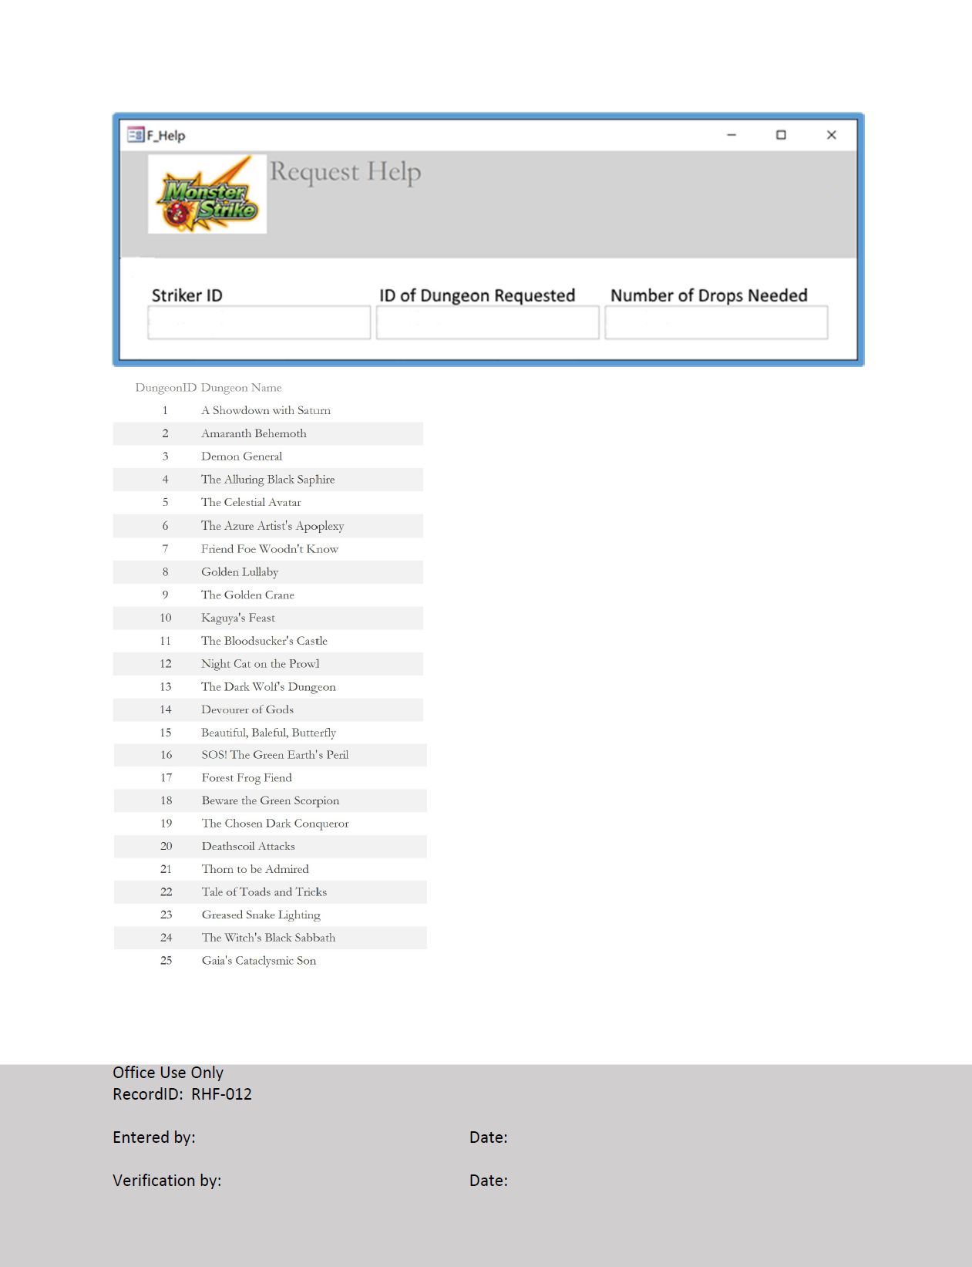
Source Documents

Slide 24
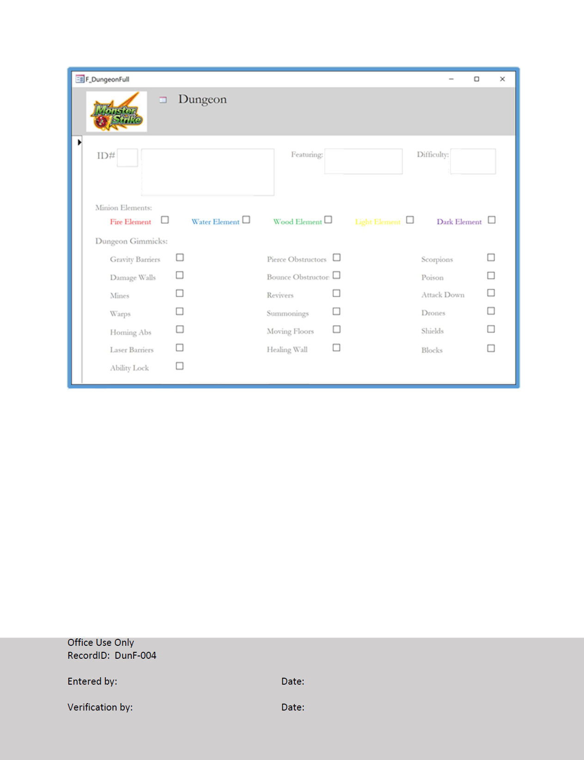
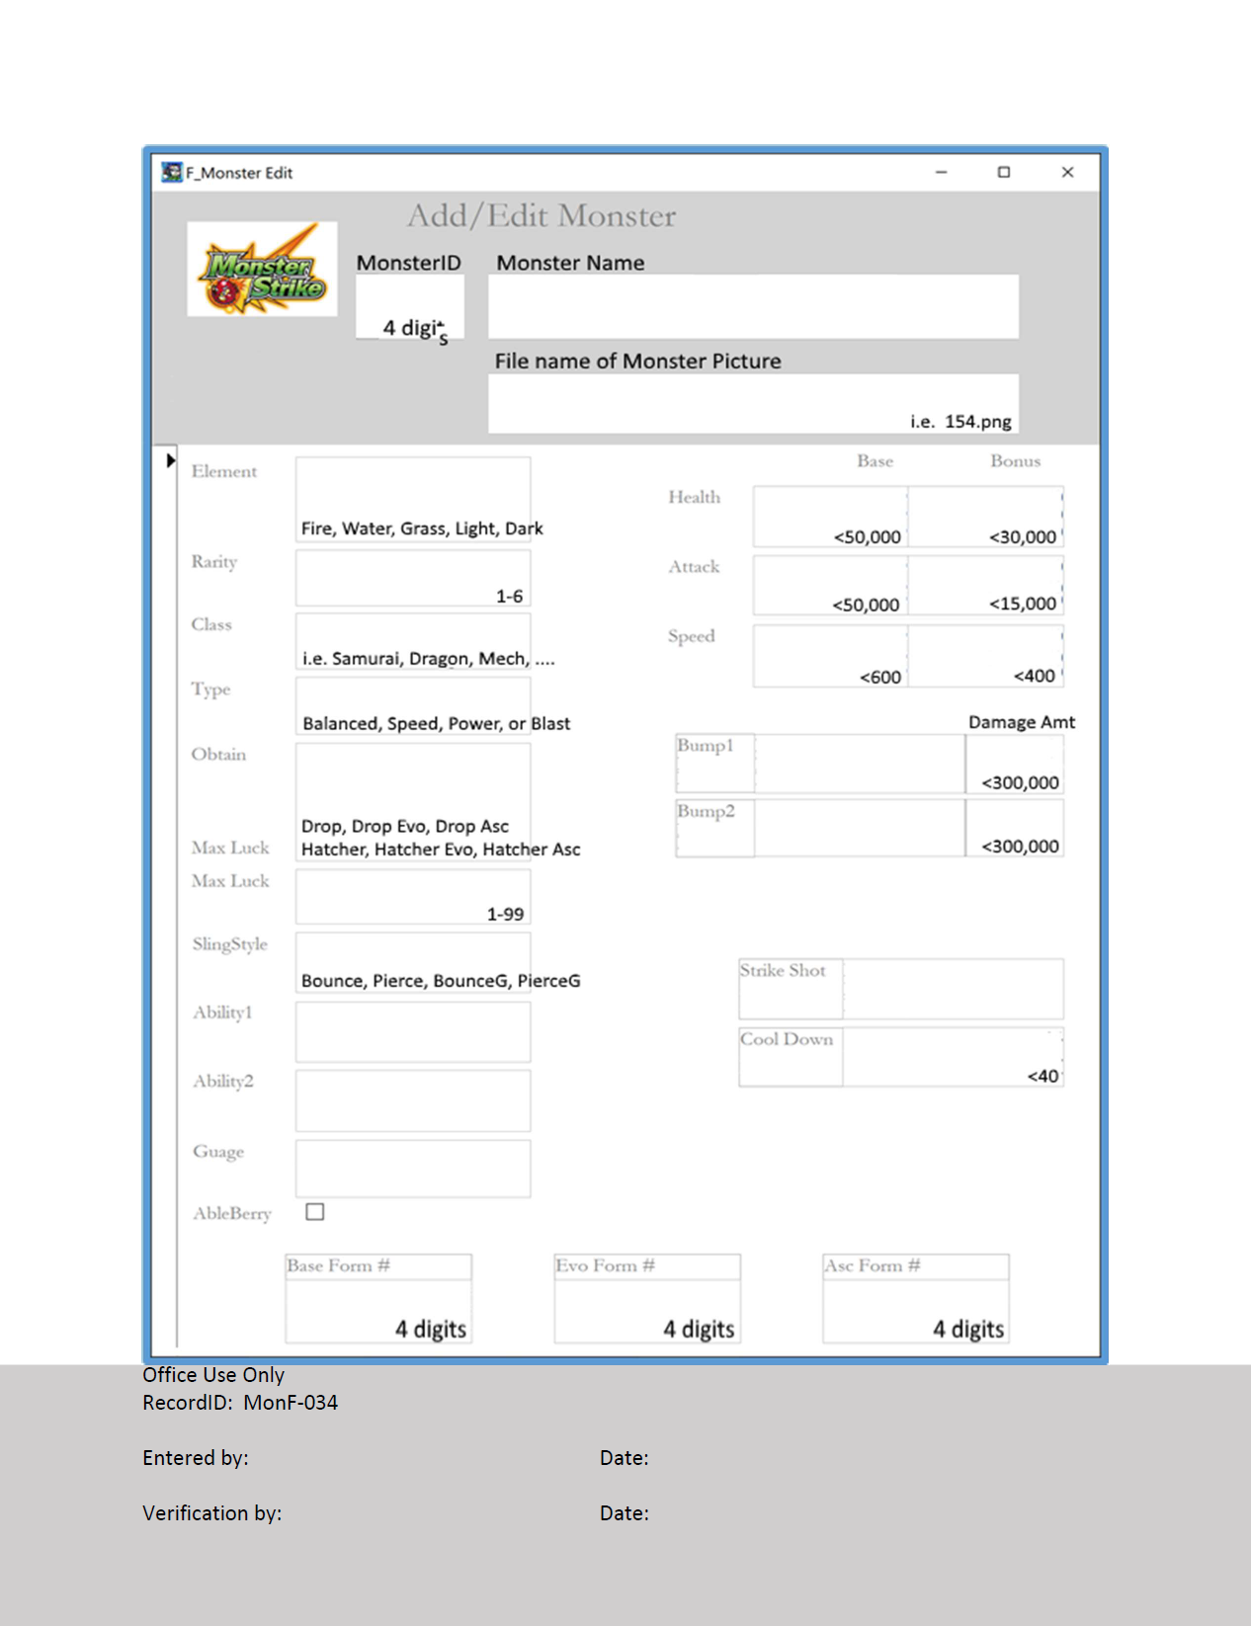
Source Documents

Slide 25
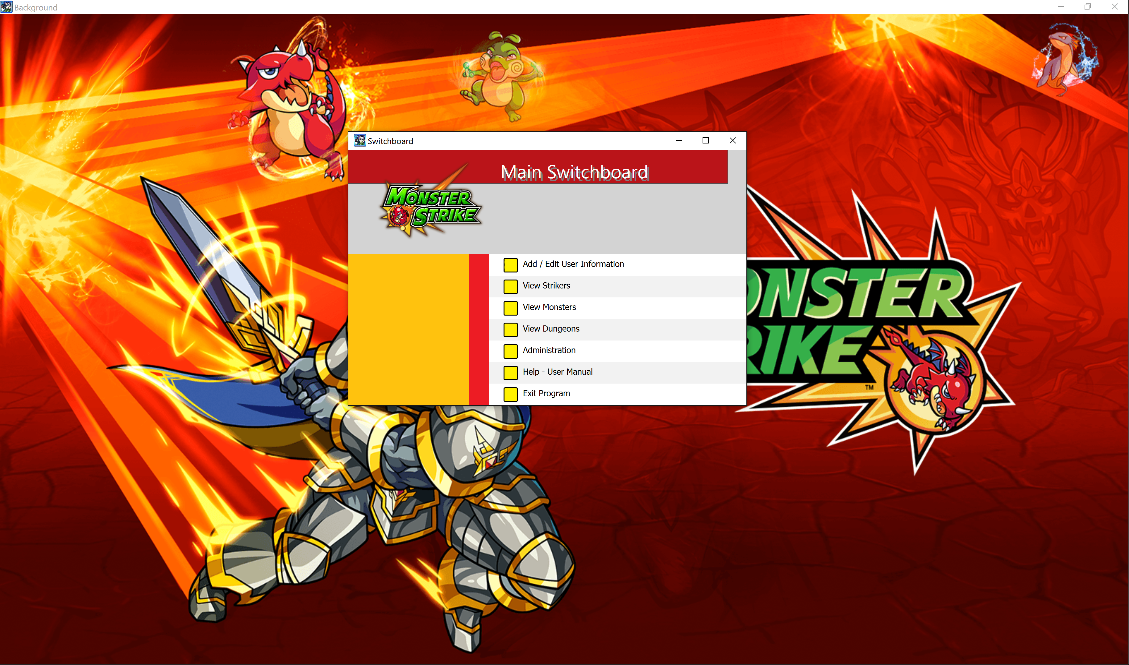
The Database

Slide 26
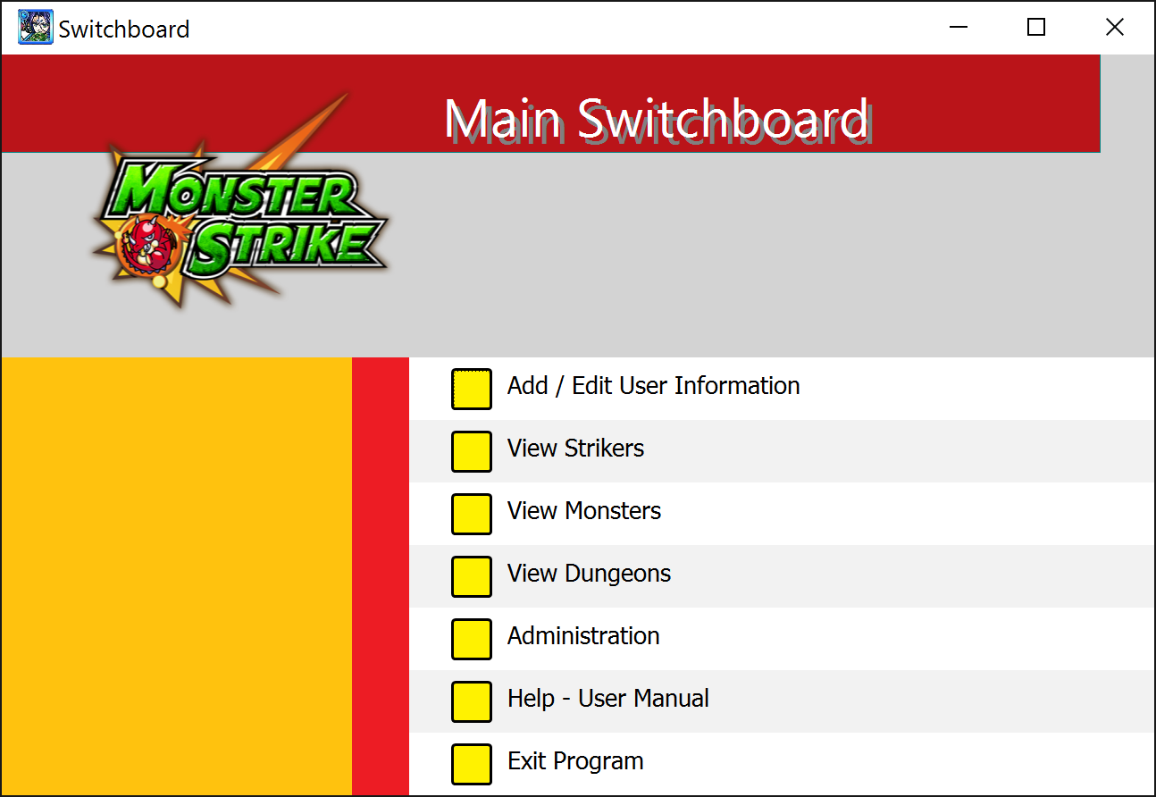
The Database Application

Slide 27
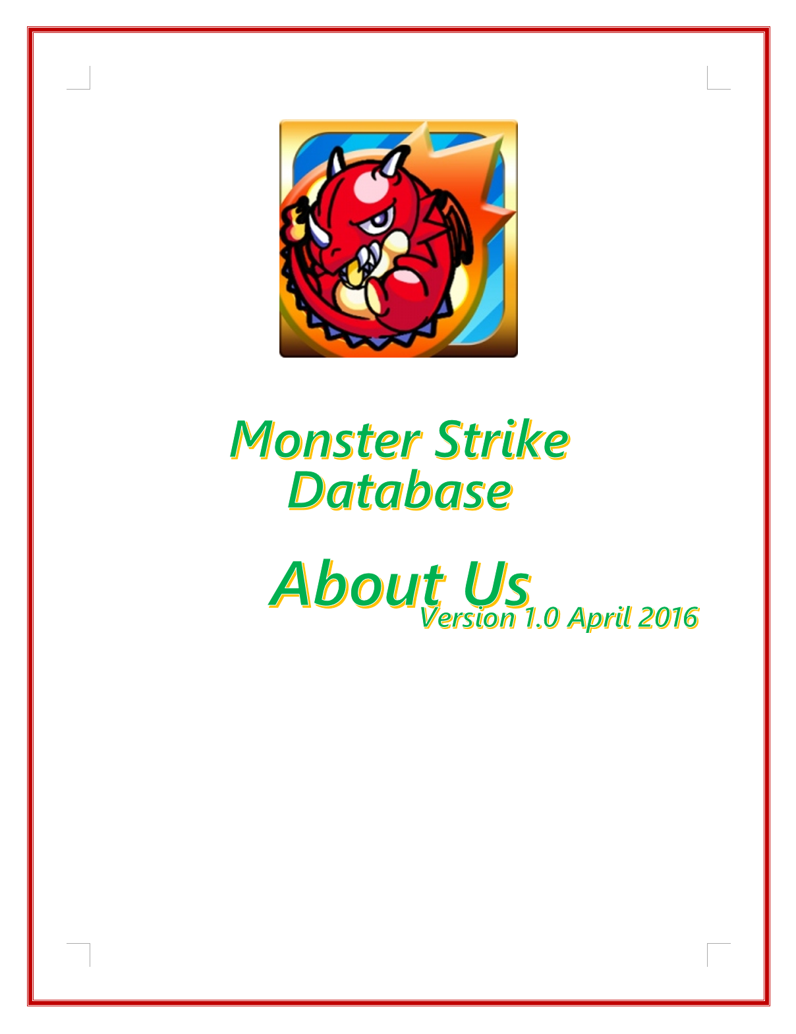
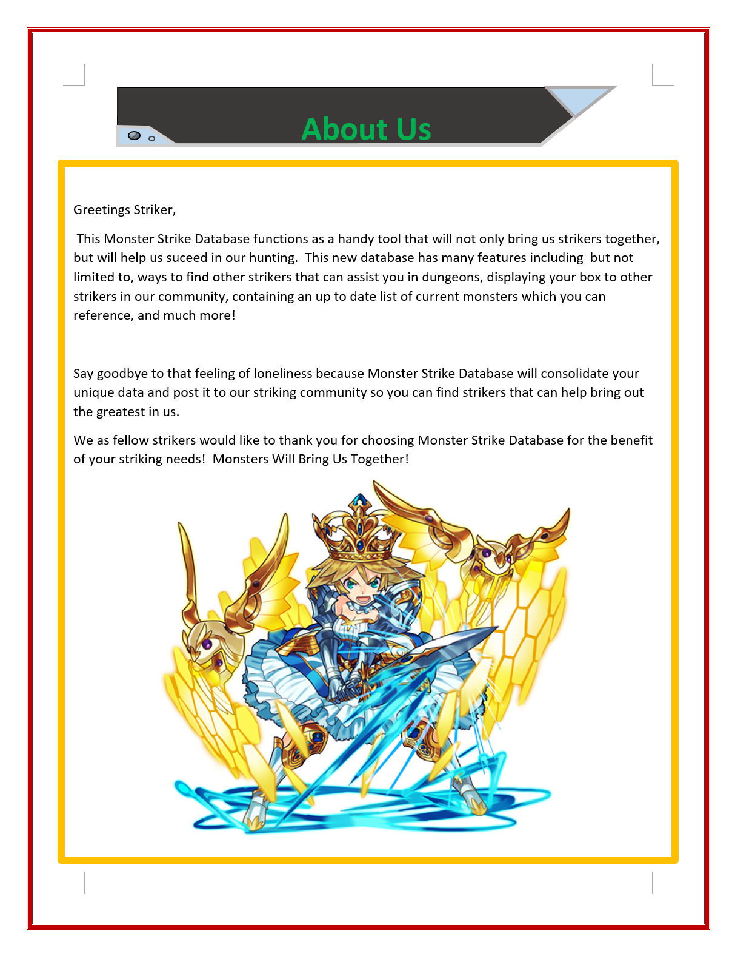
Documentation: About

Slide 28
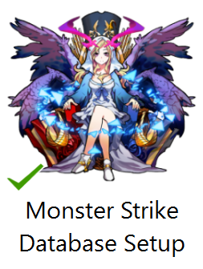
Installation Utility

Slide 29
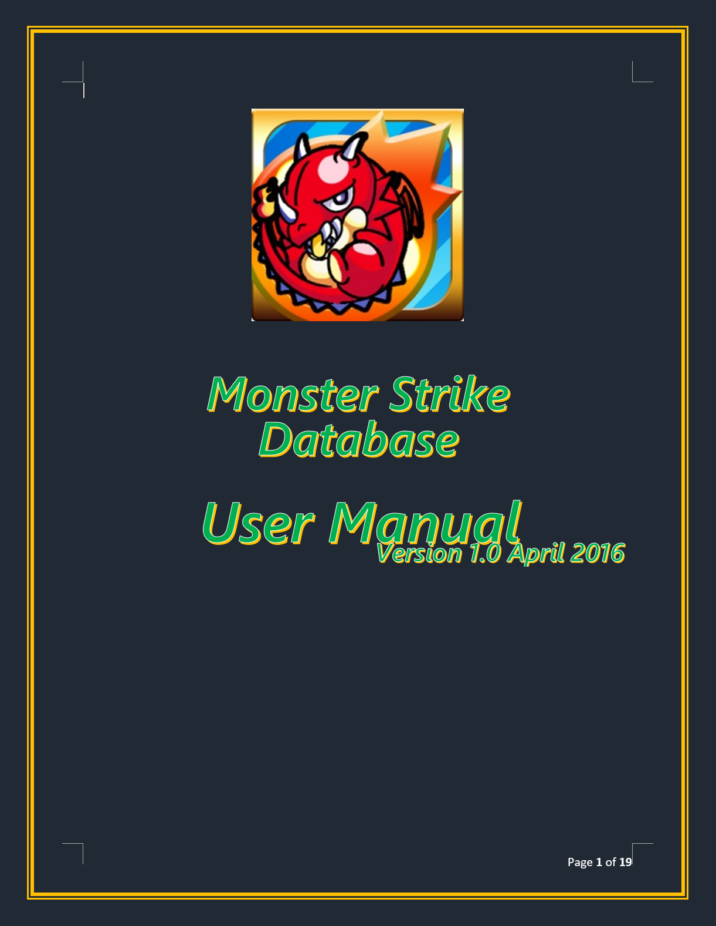
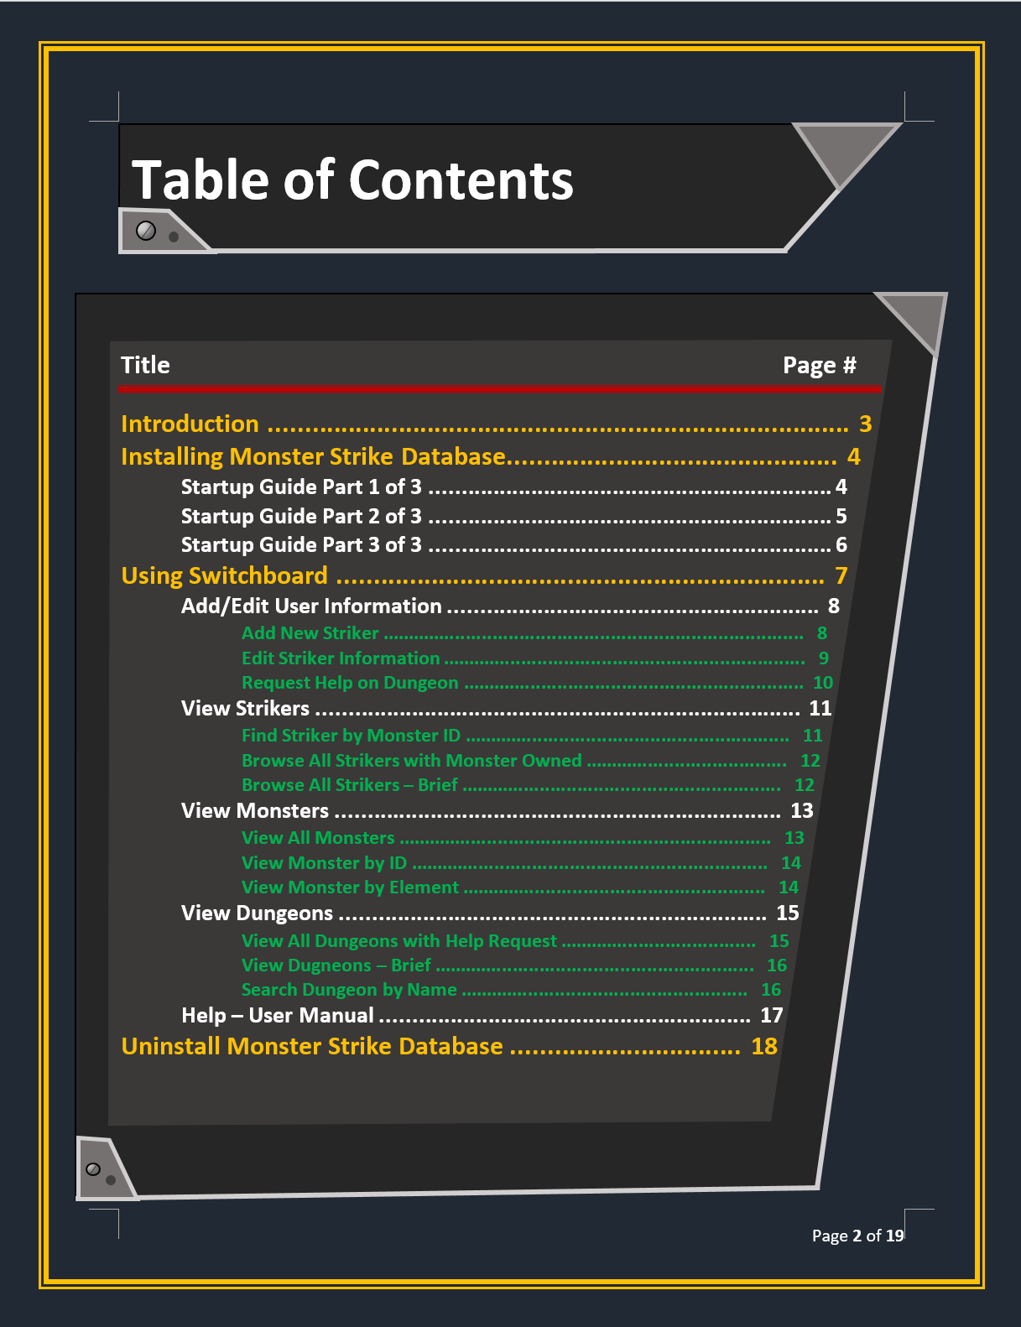
Documentation: User Manual

Slide 30
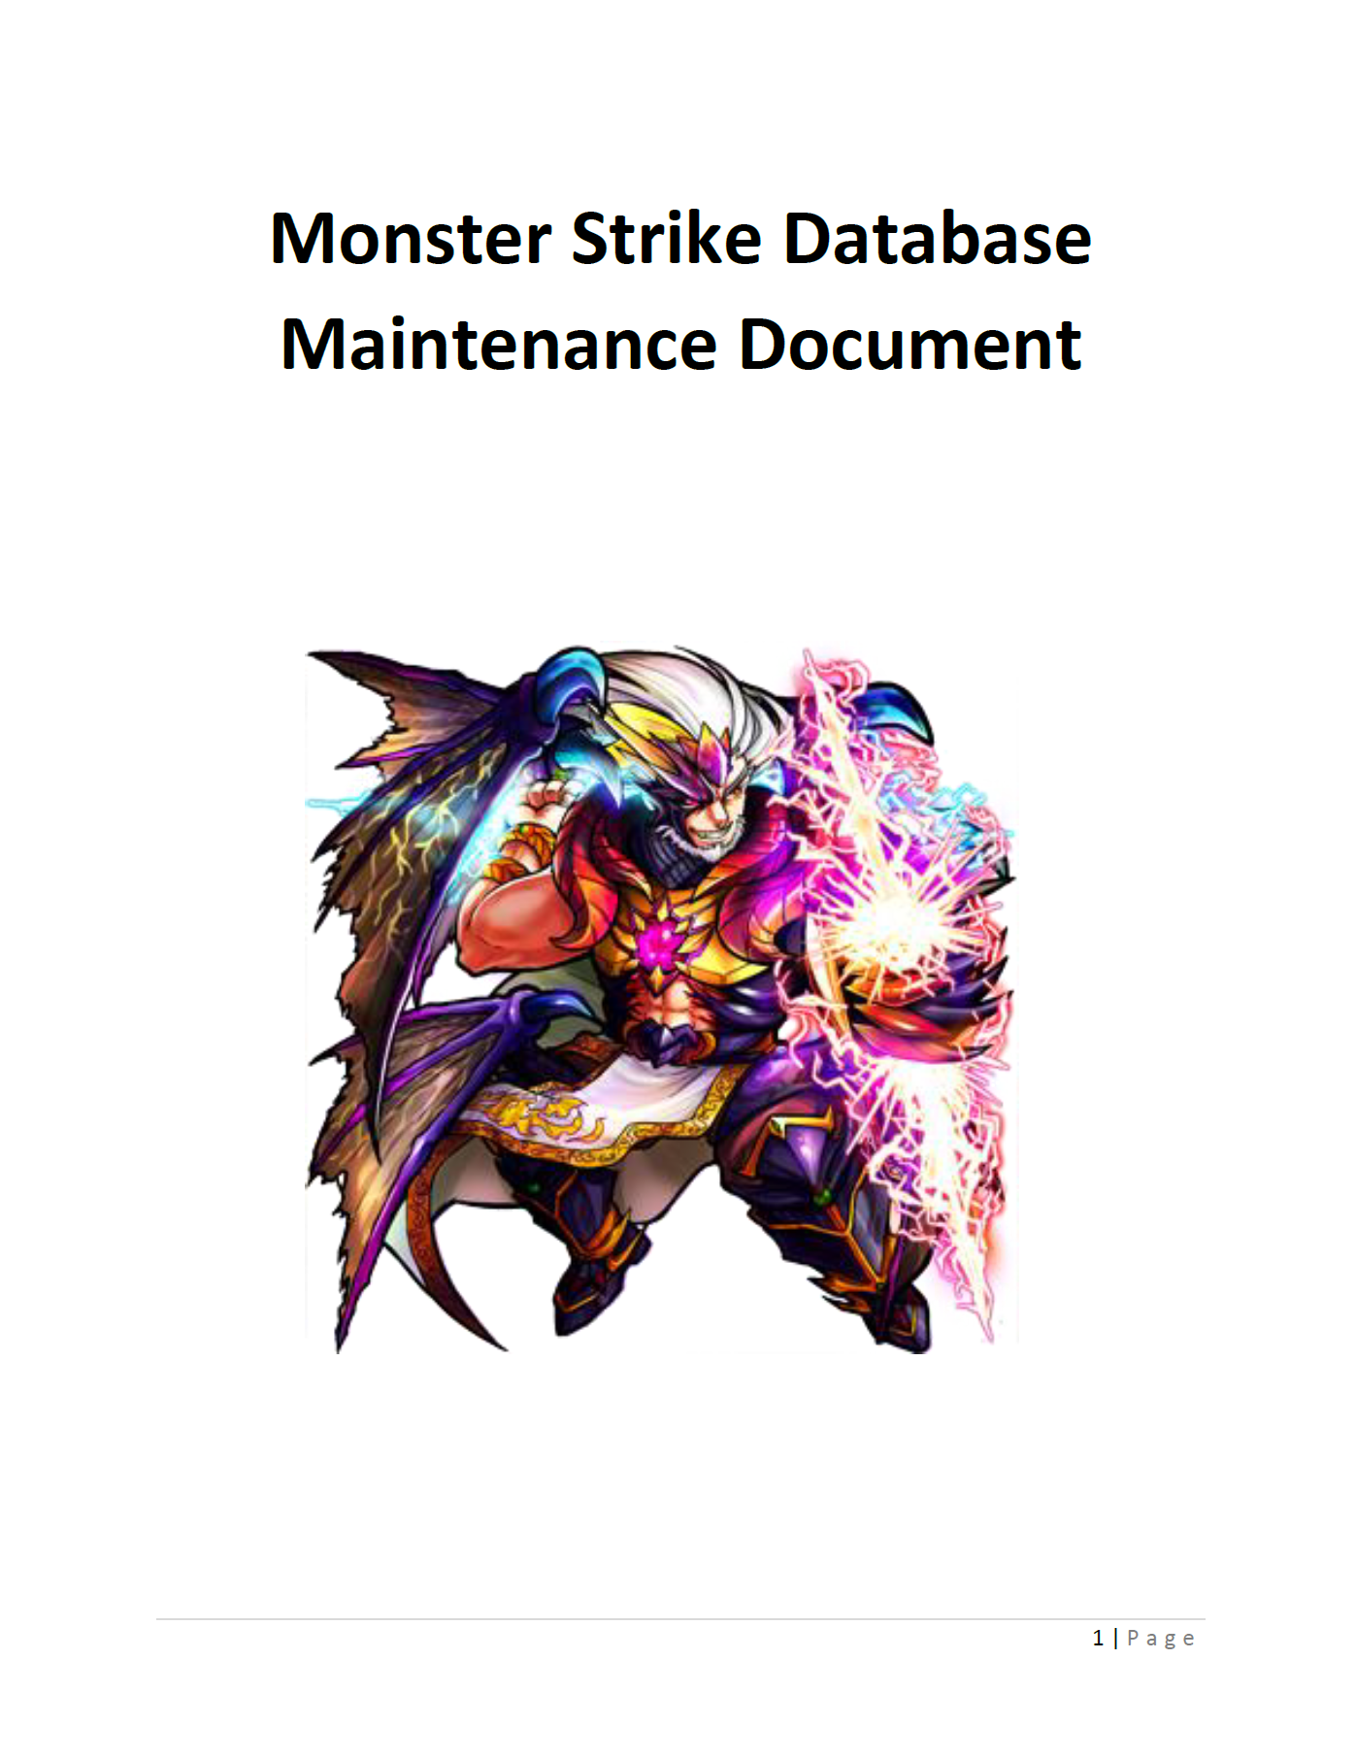
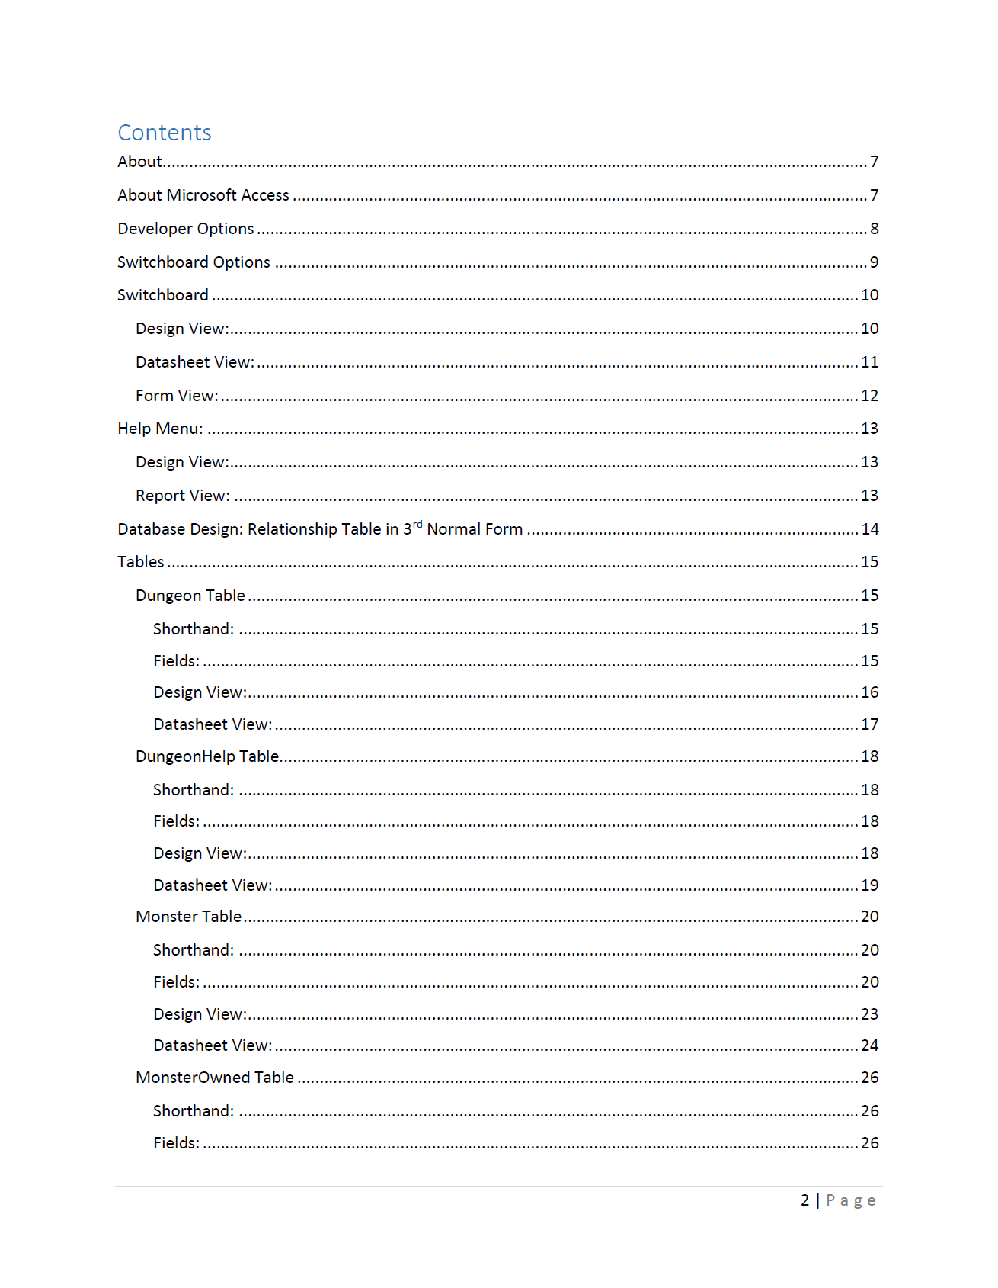
Documentation: Maintenance Manual

Slide 31
System Enhancements
Individualized User Login and Passwords
On-line Payment System
Cloud Based Database with Webhosting for Live Data – SharePoint and RunTime
Mobile Version
Live Chat Room
Full Integration into Game Website

Slide 32
System Enhancements
Notification System for Live Games
Notification System for Live On-Line Users
Renaming of All Dungeons
Full Integration of Scripting for Data Entry
Music
Video Playback System of Dungeon Runs

Slide 33
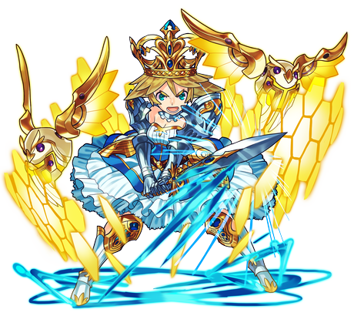
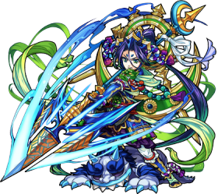
Thanks!
The Monster Strike Database Team

Slide 34
ToDo
Economic Feasibility Charts

